Slide 1
Integrated Wind and Thermodynamic
Profiling for Airport
Weather Risk Mitigation
InterMET Asia 2017
Weather, Hydrological and Climate Services
for Asia, Africa and the Pacific
Meteorology in Aviation
21-22 March -- Suntec, Singapore
Notes:
----- Meeting Notes (4/1/14 15:37) -----
Xu, Jin (Sales and Marketing), Zhang, Liu (Metstar), Liu

Slide 2
R. Ware^{1,2}, R. Baxter⁴, L. Blanchette¹, D. Berchoff^{5,6}, J. Brotzge³
W. Conway⁸, P. DeCola⁹, J. Freedman³, N. Gasperoni⁷, E. Lau¹
D. Holland¹⁰, K. Knupp¹¹, C. MacDonald¹², J. Manobianco^{5,6}
S. McLaughlin¹, K. Reed^{1,2}, P. Roller¹³, N. Sette¹³, S. Vanderburg¹⁴
A. Venkataramani^{5,16}, D. Voytenko¹⁰, P. Wiker¹⁵, T. Wilfong¹
¹Radiometrics & ²NCAR (Boulder, CO), ³State University of New York (Albany, NY)
⁴T&B Systems (Valencia, CA), ⁵TruWeather Solutions (Reston, VA)
⁶TempoQuest (Las Vegas, NV), ⁷U. Oklahoma (Norman, OK)
⁸Weather Decision Technologies (Norman, OK), ⁹Sigma Space (Lanham, MD)
¹⁰New York U. (New York, NY), ¹¹U. Alabama (Huntsville, AL)
¹²Sonoma Technology (Petaluma, CA), ¹³So. California Edison (Monrovia, CA)
¹⁴San Diego Gas & Electric (San Diego, CA)
¹⁵Clark County Air Quality Dept. (Las Vegas, NV), ¹⁶U. Massachusetts (Amherst, MA)
Notes:
----- Meeting Notes (4/1/14 15:37) -----
Xu, Jin (Sales and Marketing), Zhang, Liu (Metstar), Liu

Slide 3
Airport Weather Risk
Local high impact weather risk is closely linked to boundary layer wind and thermodynamic conditions
Continuous monitoring of these conditions is essential for accurate local weather nowcasting and forecasting
Integrated wind and thermodynamic profiling systems (WTPS) are mitigating weather risk at major airports
Notes:
3
3

Slide 4
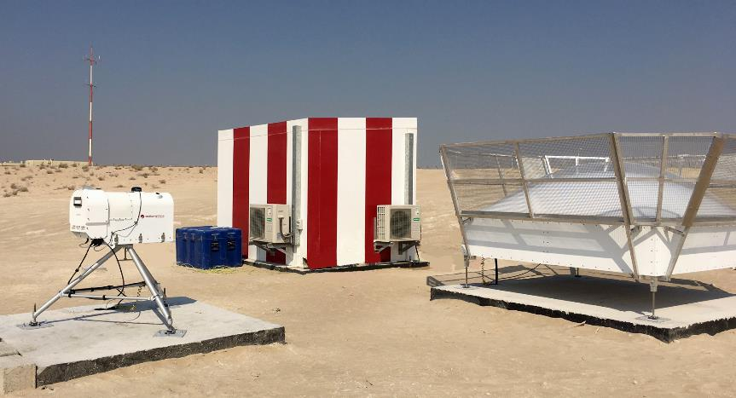
Wind & Thermodynamic Profiling System (WTPS)
Microwave Thermodynamic Profiler (MTP) and Wind Radar
Abu Dhabi International Airport (AUH)
Notes:
This figure shows the WTPS installation at AUH. This installation consists of a radiometer and XBS profiler. Data from the local AWOS (surface station) is also integrated. The instrumentation is linked to power and communications in the shelter via buried conduit run from each of the slabs shown in the figure.

Slide 5
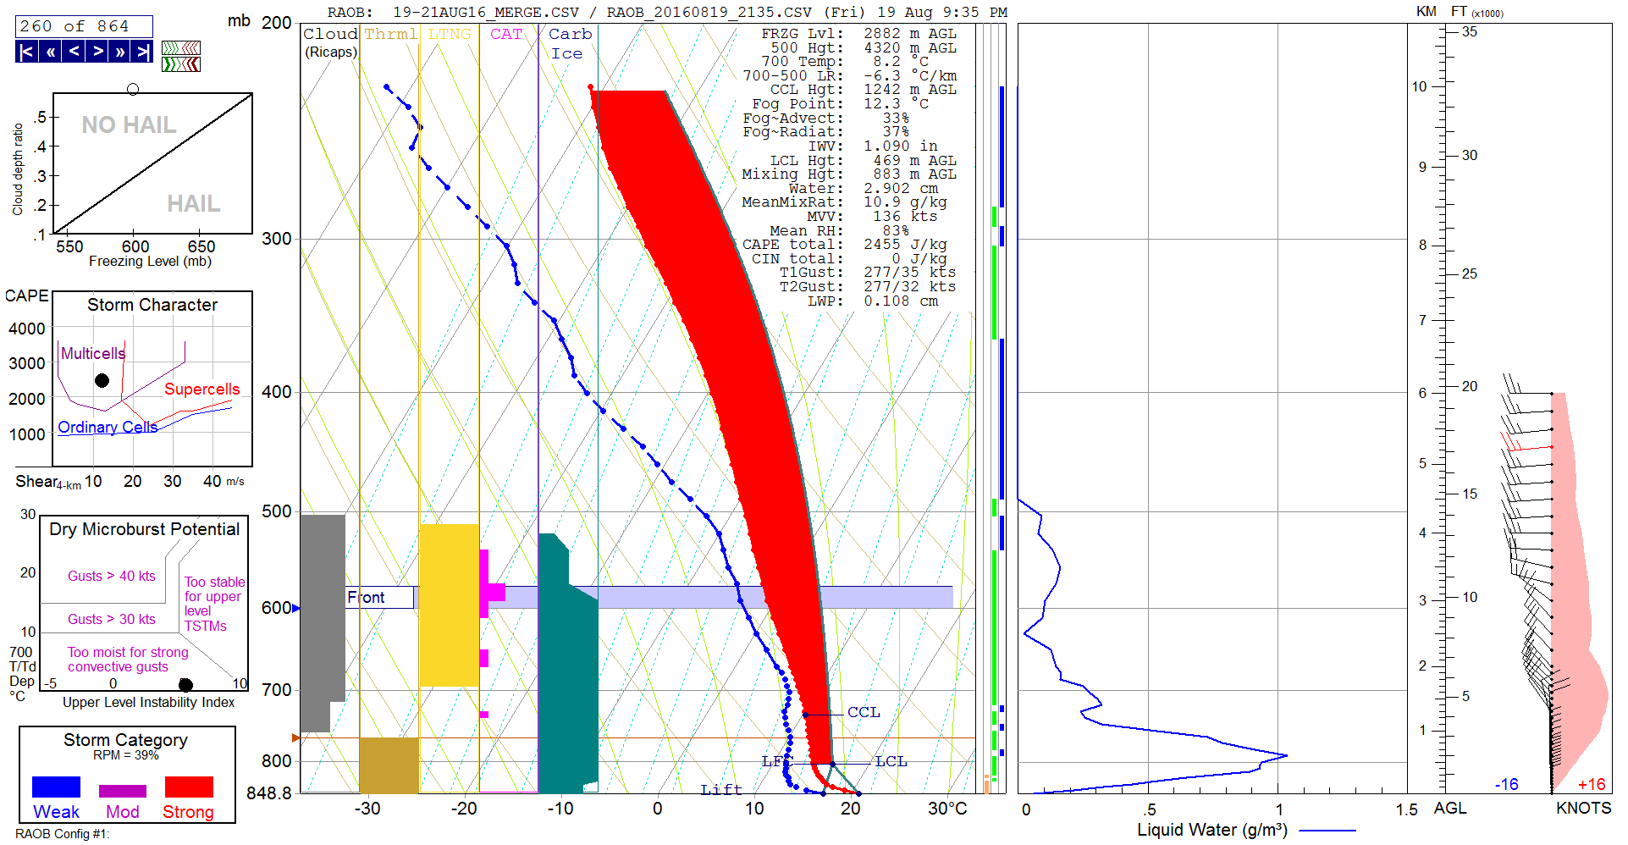
Integrated Wind & Thermodynamics
Strong Multicell Alert hours before Severe Convection
Notes:
The Sounding Toolkit allows for in-depth analysis of the latest profiler data and includes various indices which are updated with each new profile. New data are available approximately every 6 minuets.

Slide 6
SkyCast™ WTPS Installations
Abu Dhabi Int’l Airport (AUH) - 2016
Taiwan Typhoon Research Institute - 2016
Bahrain Int’l Airport (BAH) - 2015
Korean AF (7 systems, various airbases) - 2014
San Diego Gas & Electric (2 systems) - 2014
Indian AF (20 MTPs, RWPs pending) - 2013
Bangkok Int’l Airport (BKK) - 2012
Los Angeles International Airport - 2011
Dubai Int’l Airport (DXB) - 2008
Howard University Beltsville Research Facility - 2008
North Las Vegas Airport - 2007

Slide 7
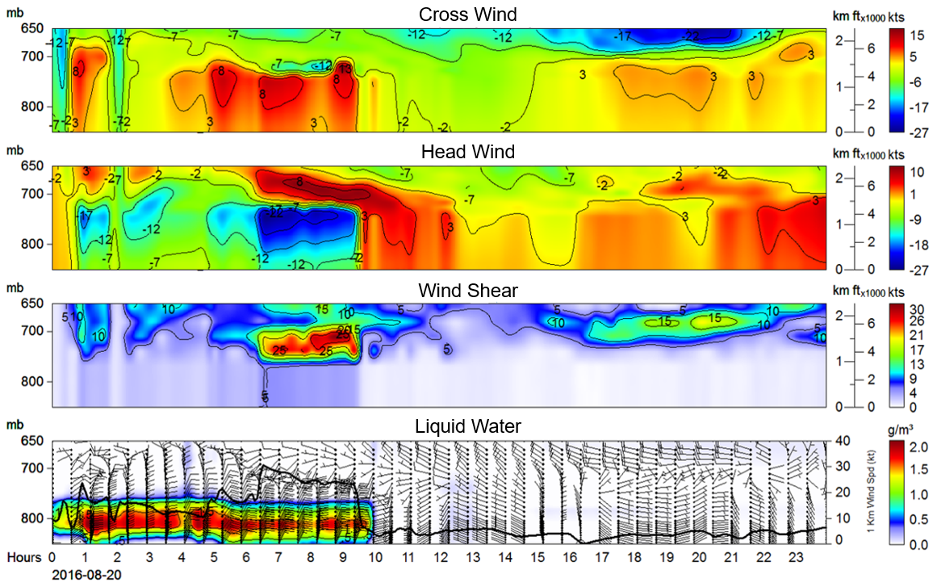
Cross & Head Wind, Vertical Wind Shear, Liquid (Fog)
Notes:
Time series example of different components related to wind shear and liquid profiles overlain with wind barbs.

Slide 8
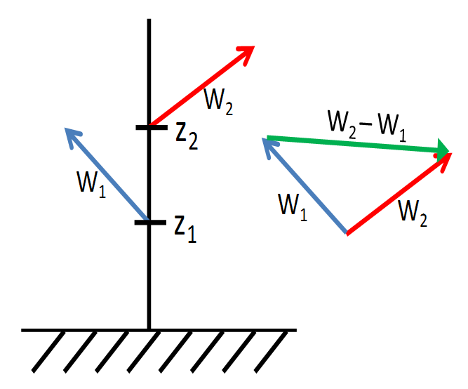
Integrated Wind Shear
Alert System (IWAS)
Vertical wind shear
= vector difference between winds at
two altitudes
Magnitude (kts/100 ft) and direction
Notes:
An important application of the WTPS is the detection of wind shear. Adjacent and layer wind velocities are checked against each other to determine the presence of wind shear.

Slide 9
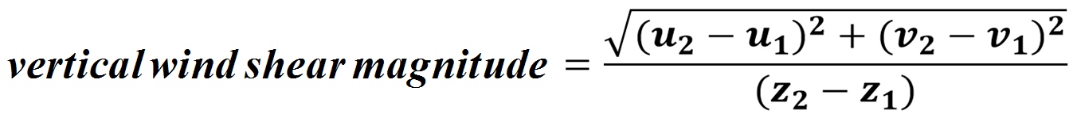

IWAS
Configurable to satisfy ICAO wind shear requirements
Windshear computed for each wind observation compared to wind at every other height
Alerting thresholds are set to
    Caution: 1.2 kts/100 ft
    Warning: 10 kts/100 ft
Default thresholds set to ICAO requirements and are also user adjustable
Notes:
Thresholds are set for magnitudes of wind shear related to caution or warning. These thresholds are adjustable.

Slide 10
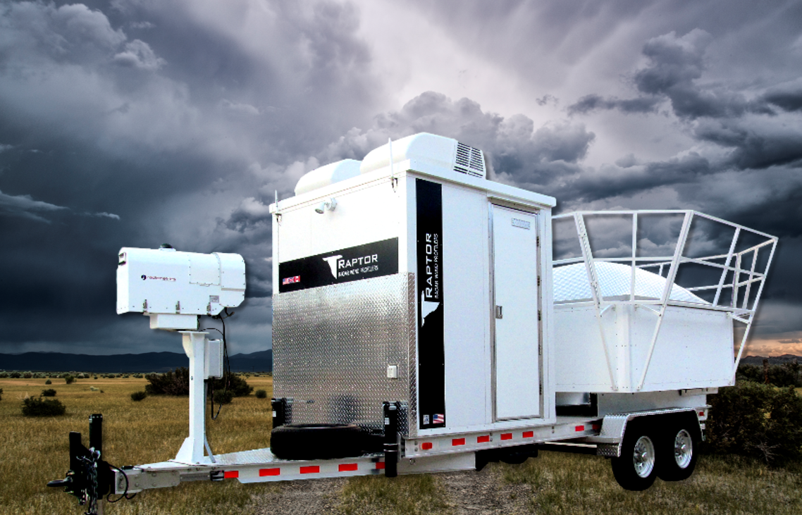
Mobile Wind and Thermodynamic Profiling System (WTPS)
Notes:
The SkyCast WTPS is able to be provided in both fixed and trailered systems.

Slide 11
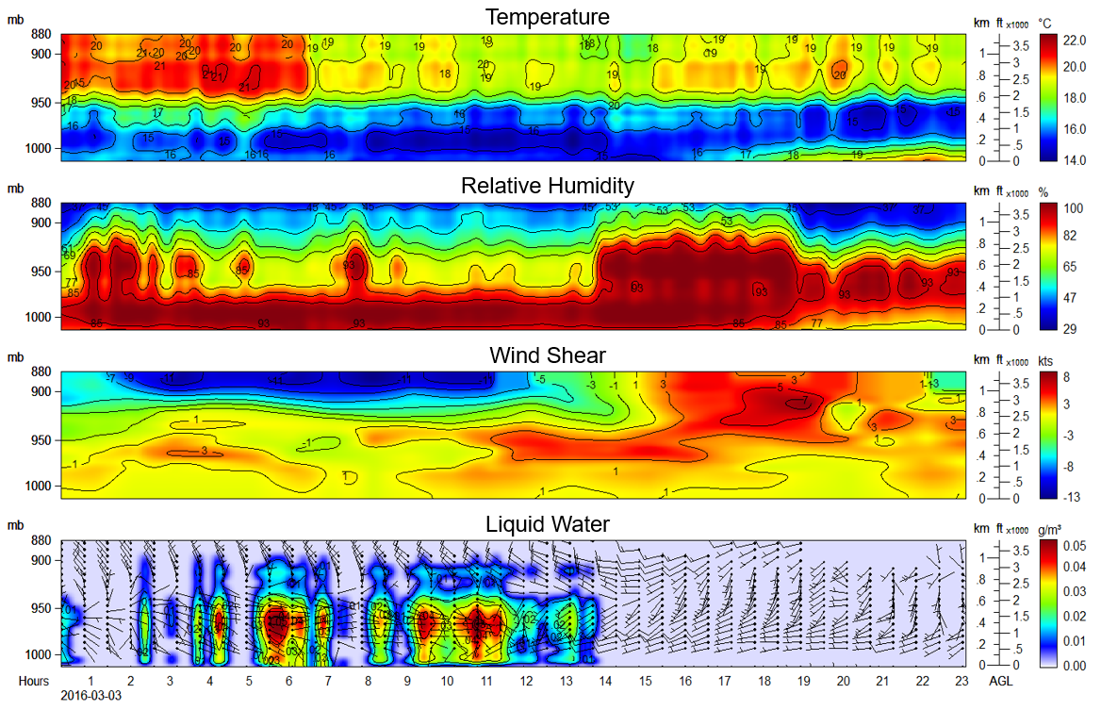
Temperature Inversion, Relative Humidity, Wind Shear,
Liquid (Fog) and Winds at Los Angeles International Airport
Notes:
Time series of thermodynamics, wind shear, and liquid water content. The time period between hours 0 and 17 show an inversion. The periods between hours 5-7 and 8-13 show fog.

Slide 12
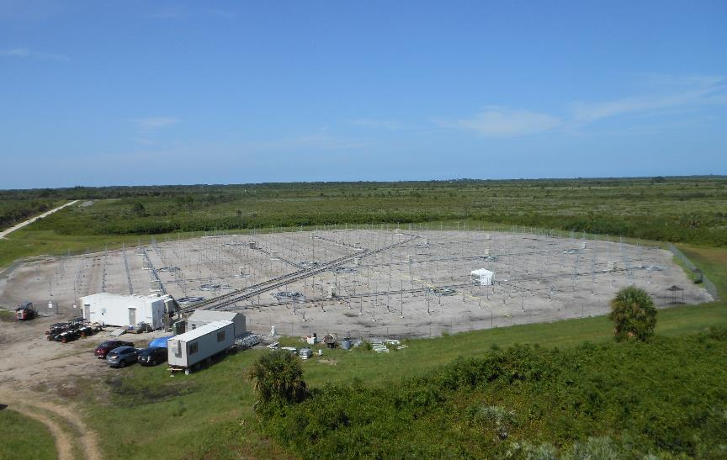
RAPTORTM 50 MHz Wind Radar at NASA Kennedy Space Center

Slide 13
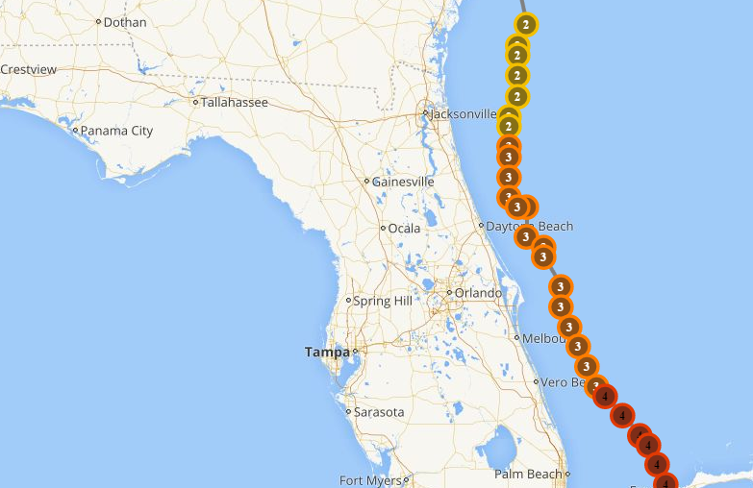
Hurricane Matthew ground track and intensity

Slide 14
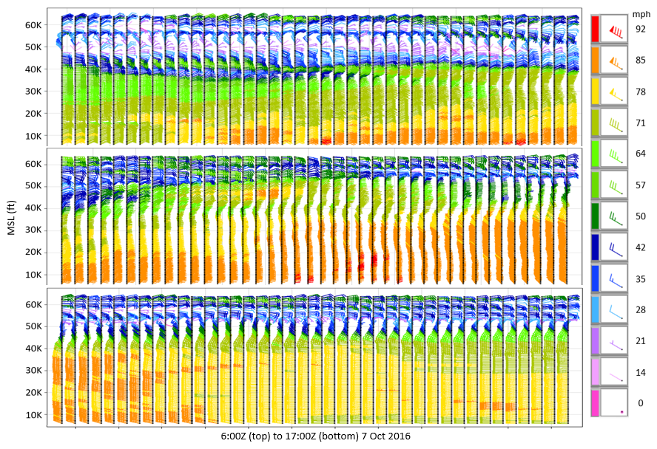
Hurricane Matthew eyewall passage 15 km from Wind Radar

Slide 15
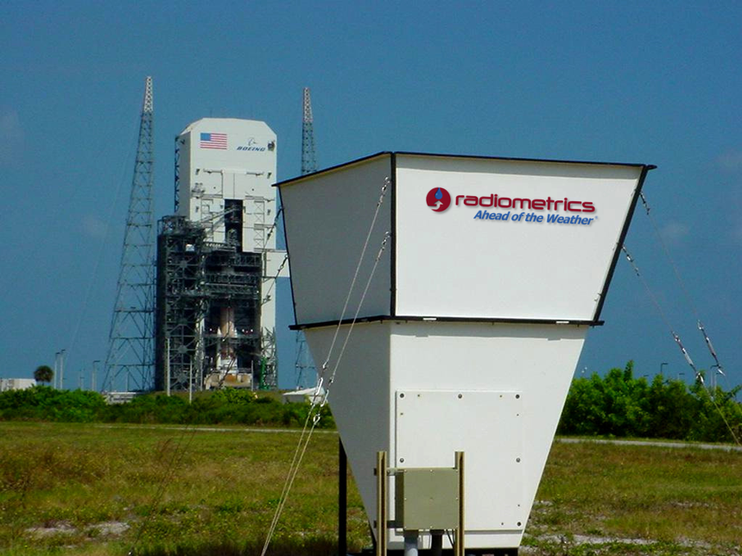
Acoustic (sodar) Low Level Wind Surveillance

Slide 16
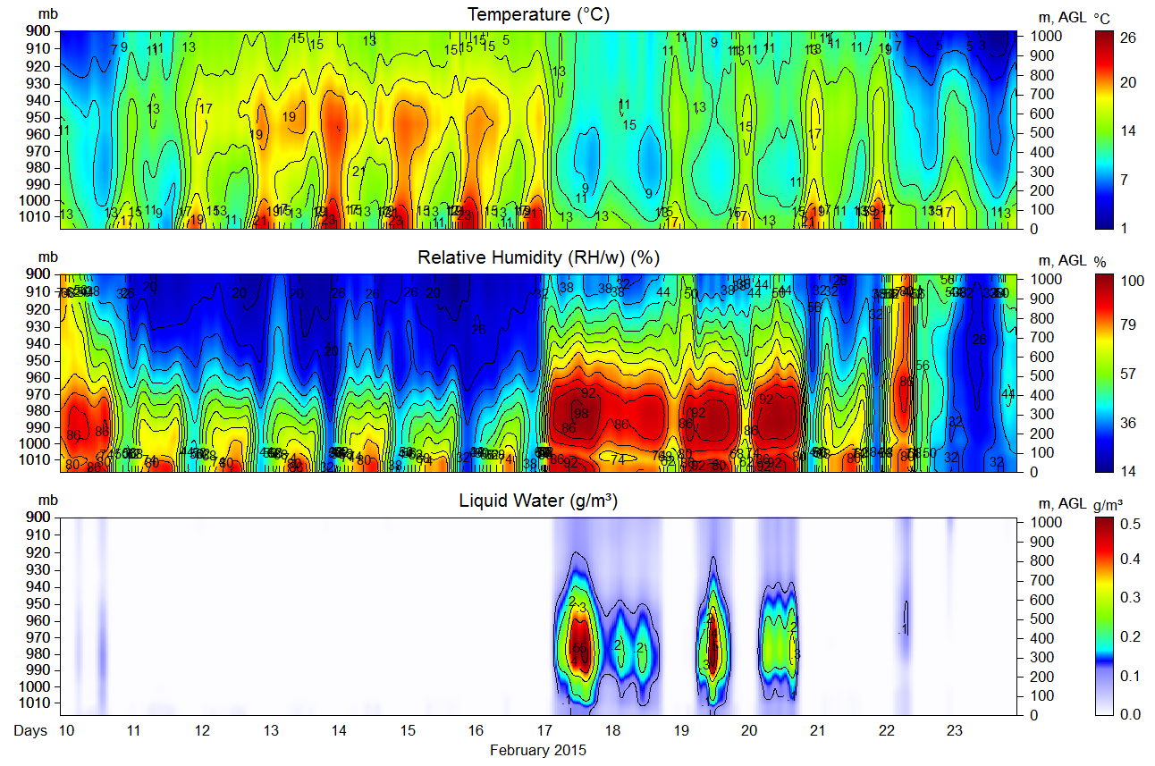
14-day MTP observations at San Francisco showing fog events
Notes:
This figure shows the WTPS installation at AUH. This installation consists of a radiometer and XBS profiler. Data from the local AWOS (surface station) is also integrated. The instrumentation is linked to power and communications in the shelter via buried conduit run from each of the slabs shown in the figure.

Slide 17
Thunderstorm Risk Identification
>2-hr in Advance
“…ground-based MWR observations can be used effectively to predict the occurrence of thunderstorms at least 2 h in advance.”
(Madhulatha et al, JGR, 2013)
Thunderstorm risks include: Lightning, Hail, Rain, Gust Fronts, Turbulence, Wind Shear
Notes:
17

Slide 18
MTP lightning alert >2 hr in advance (Madhulatha et al, JGR, 2013)

Slide 19
Severe Storm Precursors
Severe thunderstorms killed 22 and left millions without power for five days in Washington, DC
Microwave Thermodynamic Profiler (MTP) observations and derived forecast indices
MTP-derived Forecast Indices showed extremely unstable conditions and high wind risk 10 hours in advance
Notes:
19
19

Slide 20
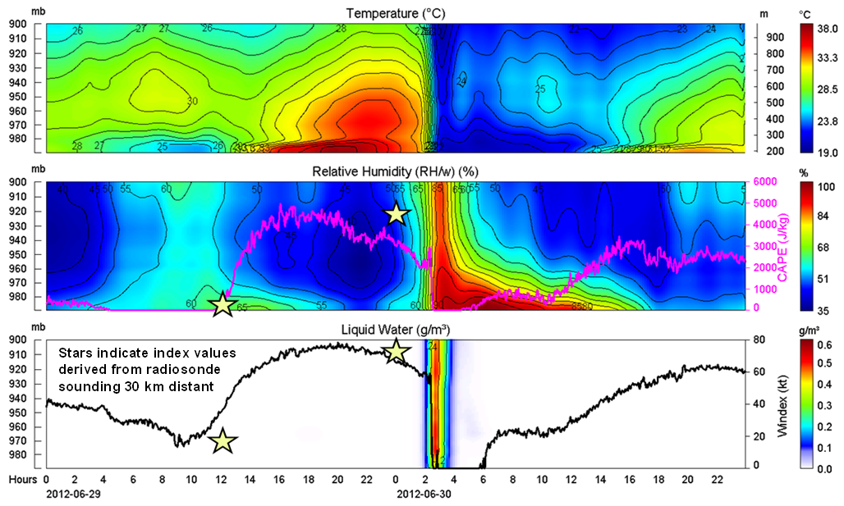
MTP observations of severe thunderstorms that killed 22
and caused 5-day power outage in Washington, DC

Slide 21
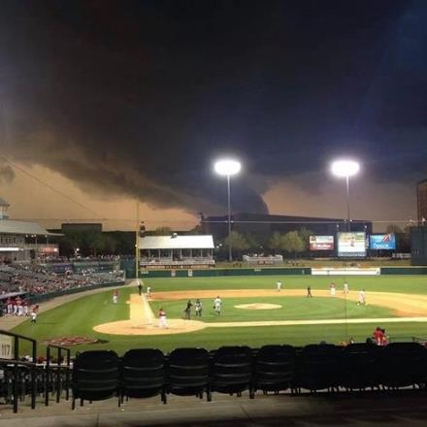
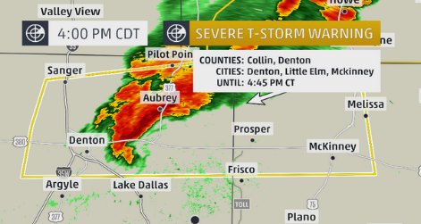
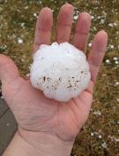
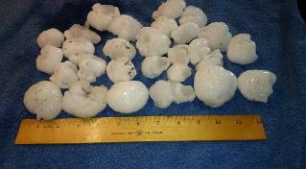
  THE NATIONAL WEATHER SERVICE IN FORT WORTH HAS ISSUED A
  * TORNADO WARNING FOR… CENTRAL DENTON COUNTY IN NORTH
  CENTRAL TEXAS…
  * UNTIL 630 PM CDT 3 April 2014
  * THE TORNADO WILL BE NEAR… DENTON AROUND 605 PM CDT
Notes:
21

Slide 22
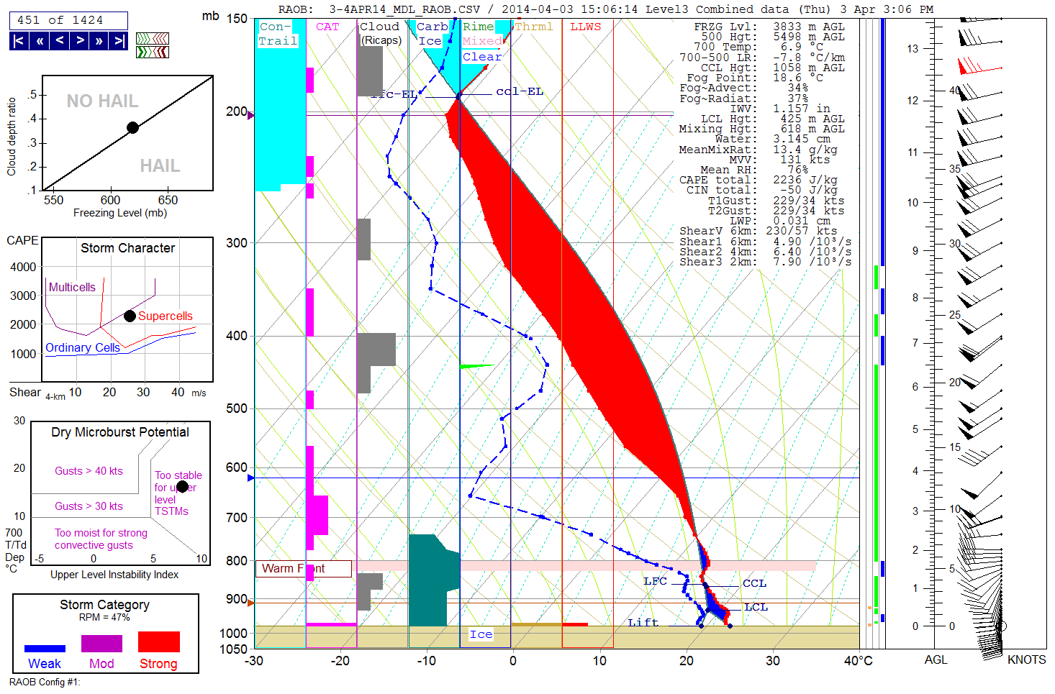
MTP thermodynamics and model winds 3 hr before Denton Tornado

Slide 23
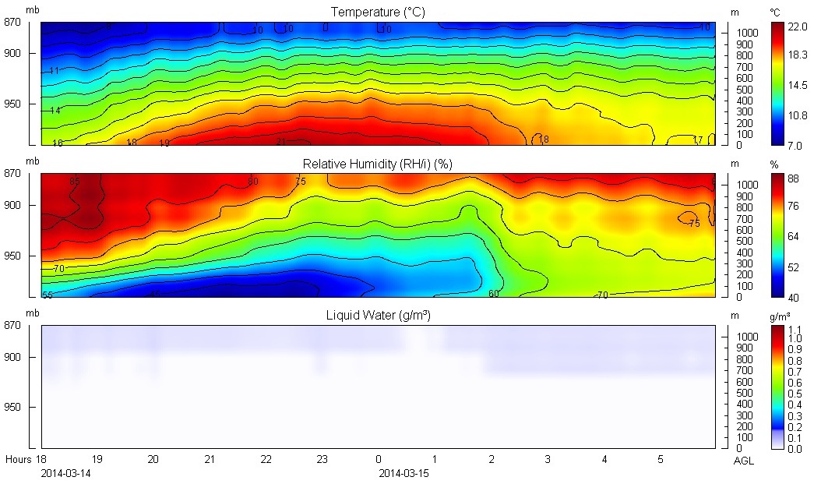
Thermodynamics during stable conditions

Slide 24
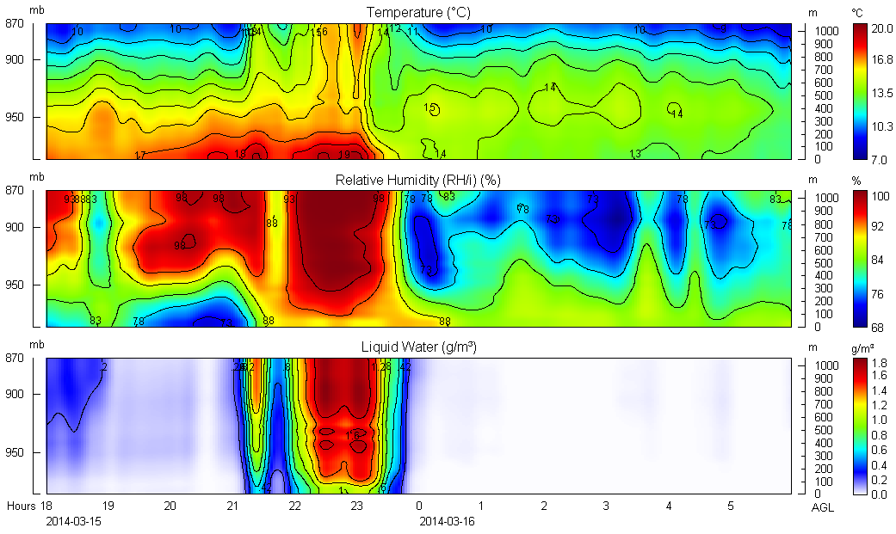
Thermodynamic variability during unstable conditions

Slide 25
New York State
Mesonet
17 Wind & Thermodynamic Profilers (WTPS)
125 Environmental Monitoring Sites

Slide 26
SkyCast™ Total
Profiling Solutions
Continuous Wind, Temperature, Humidity & Liquid Soundings
Cross, Head, & Tail Wind, and
Vertical Wind Shear Alerts
Fog, Inversion & Icing Advisories
Thunderstorm, Downburst & Lightning Risk Identification

Slide 27
Bottom Line
High impact local weather originates in the planetary boundary layer, where it exacts its personal and economic tolls
Continuous boundary layer wind and thermodynamic soundings are crucial for accurate high impact local weather forecasting
Boundary layer wind and thermodynamic surveillance is key to airport weather risk mitigation

